Slide 1
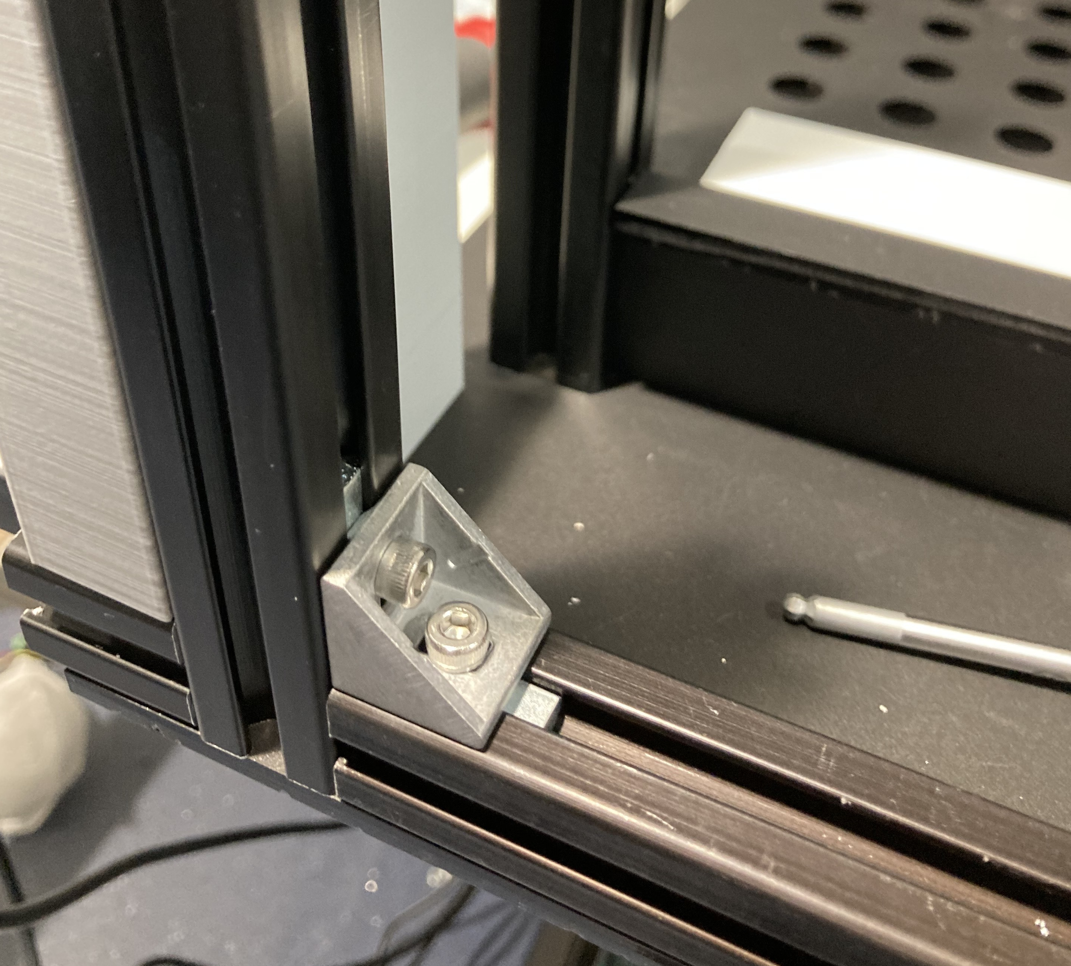
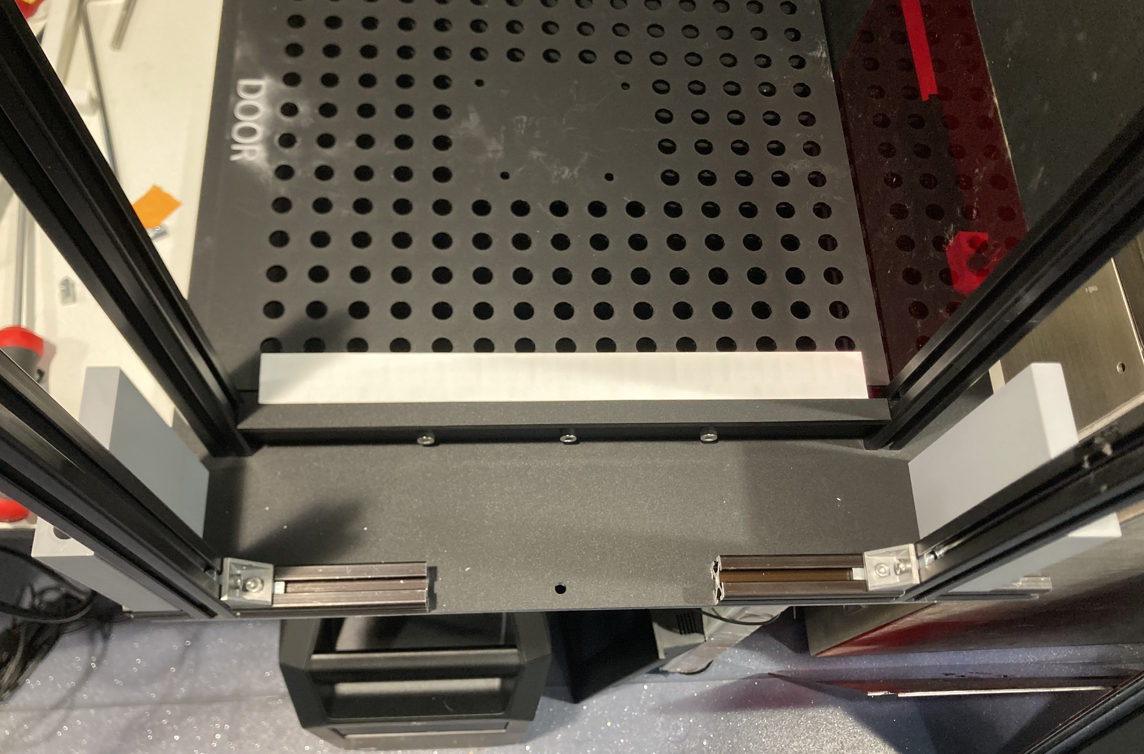
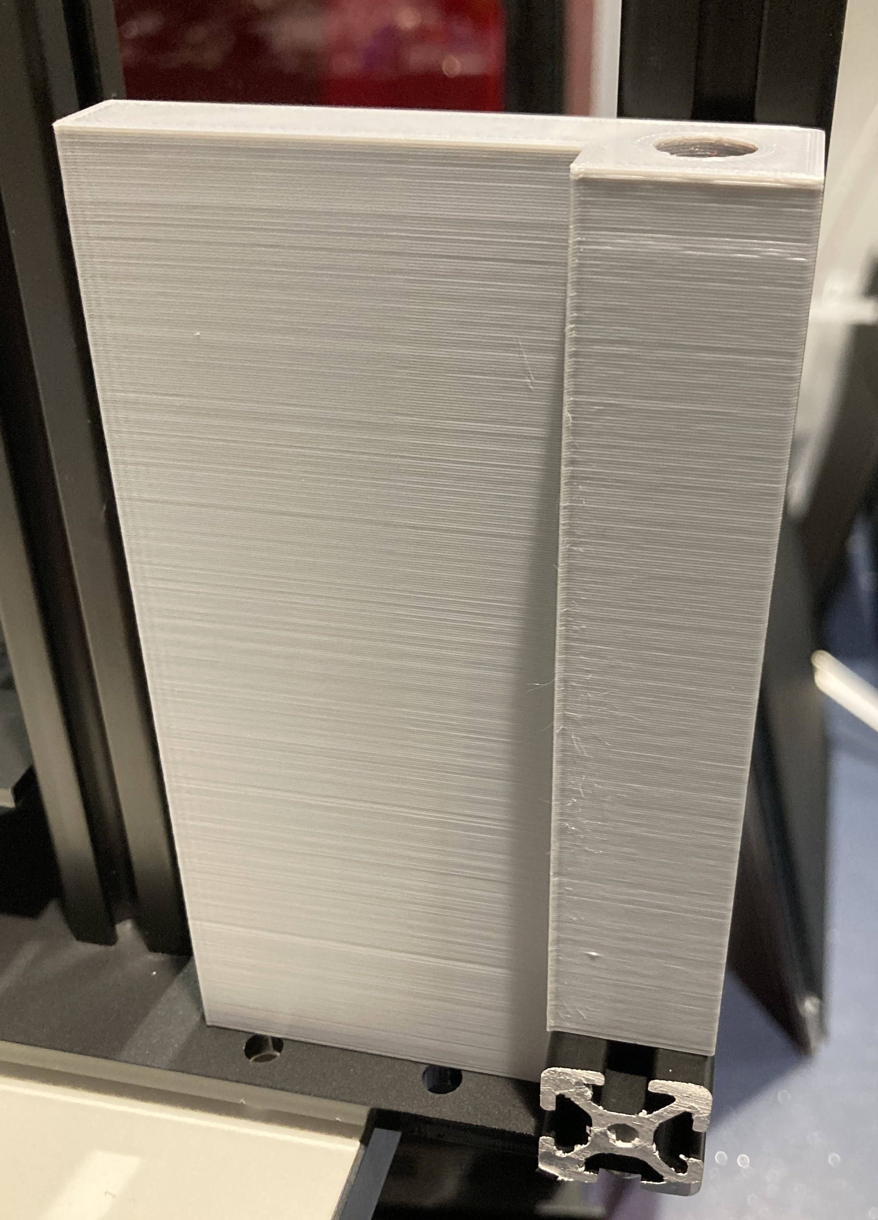
M4 t-slot nut
M4 x 8mm
angle bracket
touchscreen
mount L
FACING ↑
TOUCHSCREEN GOES HERE
M5 x 30mm
(not visible)
touchscreen
mount L
touchscreen
mount R
M5 t-slot nut
(not visible)

